Slide 1

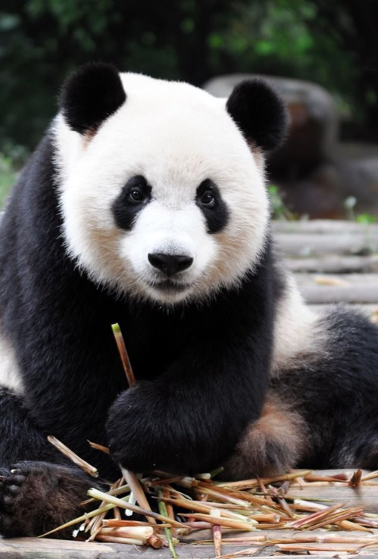

Introduction to Programming
Pandas
Created By Jai Somaiya

Slide 2
Recap
What are the different types of lists?
What is the difference between indexing and slicing?
How do you use indexing in a dictionary?
What does the code above do?

Slide 3
Learning Objectives
Aim:
To understand the use of the Pandas Package in Python.
Objective
To check understanding of the basics of using panda’s library.
To use pandas to read, write and filter data from / to a CSV file.
To group and sort data in a CSV file.

Slide 4
What is Pandas?
Pandas is a Python library used for working with data sets.
It has functions for analysing, cleaning, exploring, and manipulating data.
The name "Pandas" has a reference to both "Panel Data", and "Python Data Analysis" and was created by Wes McKinney in 2008.

Slide 5
Why use Pandas?
Pandas allows us to analyse big data and make conclusions based on statistical theories.
Pandas can clean messy data sets and make them readable and relevant.
Relevant data is very important in data science.
:}
Data Science: is a branch of computer science where we study how to store, use and analyse data for deriving information from it.

Slide 6
What Can Pandas Do?
Pandas gives you answers about the data. Like:
Is there a correlation between two or more columns?
What is average value?
Max value?
Min value?
Pandas are also able to delete rows that are not relevant, or contains wrong values, like empty or NULL values. This is called cleaning the data.

Slide 7
Getting Started
Pandas will require you to install the package on your PC. Using the follow command:
pip install pandas
We already have this installed. So, we are ready to use this. To use this package in your scripts you will need to import it.
import pandas

Slide 8
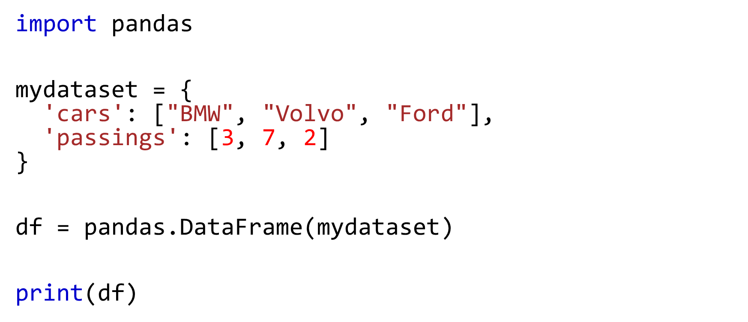
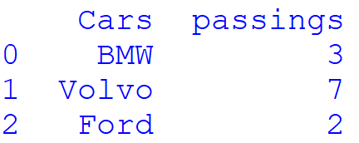
Example
Index
Keys
Values

Slide 9
Using an Alias
Pandas is usually imported under the pd alias.
Create an alias with the as keyword while importing:
import pandas as pd

Slide 10
Creating Data
There are two core object in pandas: the DataFrame and Series.
A Pandas DataFrame is a 2-dimensional data structure, like a 2-dimensional array, or a table with rows and columns.
A Pandas Series is like a column in a table.
It is a one-dimensional array holding data of any type.

Slide 11
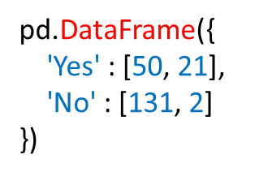
DataFrame
A DataFrame is a table it contains an array of individual entries, each of which has a certain value.
For example, consider the following simple DataFrame:

Slide 12

DataFrame
We are using the pd.DataFrame constructor to generate these DataFrame objects. The syntax for declaring a new one is a dictionary whose key are the column names and whose values are a list of entries.
This is the standard way of constructing a new DataFrame, and the you are most likely to encounter.

Slide 13
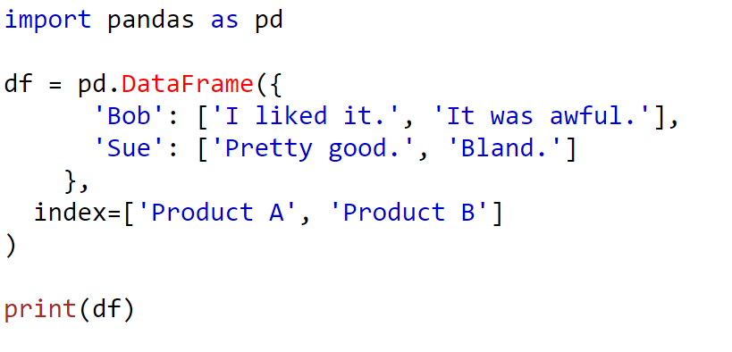
What does this do?

Slide 14
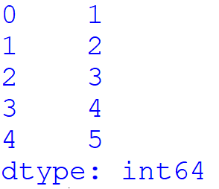
Series
A Series, by contrast, is a sequence of data values. If a DataFrame is a table, a Series is a list. And in fact you can create one with nothing more than a list:
pd.Series([1, 2, 3, 4, 5])
Index
Values
Value Data Types

Slide 15

Series
A series, in essence, a single column DataFrame. So, you can assign column values to the series the same way as before, using an index parameter. However, a Series does not have a column name, it only has one overall name.

Slide 16
Reading Data Files
Being able to create a DataFrame or Series by hand is handy.
But most the time, we won’t be creating our own by hand. Instead, we will be working with data that already exists.
Data can be stored in any number of different forms and formats. By far the most basic of these is the humble CSV file.

Slide 17
CSV File
When you open a CSV file you get something like this:
Product A,Product B,Product C
30,21,9
35,34,1
41,11,11
So a CSV file is a table of values separated by commas. Hence the name “Comma-Separated Values” of CSV

Slide 18
Reading a CSV File
The CSV file I am going to be using is called “pokemon_data.csv”, I have saved this in the same location I have my python file.
To read this you need to use the pd.read_csv() function the data into a DataFrame
URL to CSV
Variable
Function

Slide 19
DataFrame Attributes and Functions
pokemon_stats.shape – to check how large the resulting DataFrame is.
pokemon_stats.head() – gets first five rows, you could also specify the number of rows by entering a number as a parameter.
pokemon_stats.tail() – gets last five rows, you could also specify the number of rows by entering a number as a parameter.

Slide 20
Automated Index Column
The pd.read_csv() function has 30 optional parameters you can specify.
For example, you can see this dataset that the CSV file has a built-in index, which pandas did not pick up automatically. To make pandas use the ‘#’ column as the index instead of creating a new one, we can specify an index_col.
pokemon_stats = pd.read_csv("pokemon_data.csv", index_col=0)

Slide 21

Activity
Complete the worksheet on moodle named Creating, Reading and Writing.
There is a csv file named ‘wine_reviews.csv’

Slide 22
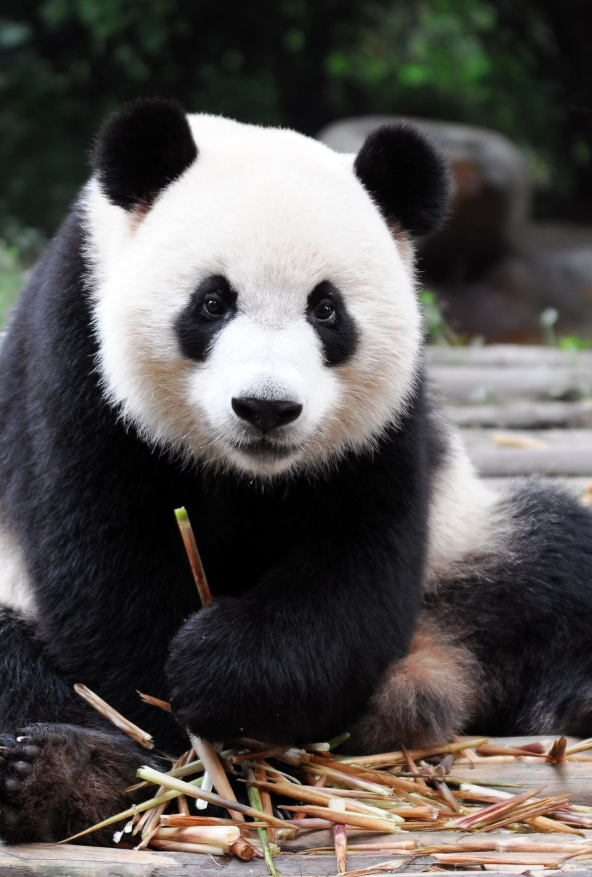
Next Week
We will look at Summary Functions and Start looking at Inserting, Selecting and Assigning in Pandas.

